Slide 1
Chapter 11-Analog to Analog Conversion

Slide 2

Introduction
Analog-to-analog conversion is the representation of analog information by an analog signal. One may ask why we need to modulate an analog signal; it is already analog. Modulation is needed if the medium is bandpass in nature or if only a bandpass channel is available to us.

Slide 3
Amplitude Modulaton
In AM transmission, the carrier signal is modulated so that its amplitude varies with the changing amplitudes of the modulating signal.
The frequency and phase of the carrier remain the same.
Only the amplitude changes to follow variations in the information.
The modulating signal becomes an envelope to the carrier.

Slide 4

Amplitude Modulaton

Slide 5
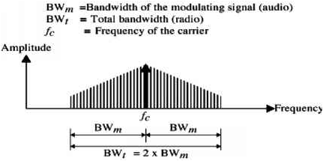
Bandwidth of AM
The bandwidth of an AM signal is equal to twice the bandwidth of the modulating signal and covers a range centered around the carrier frequency.
The bandwidth of an audio signal (speech and music) is usually 5 KHz. Therefore, an AM radio station needs a minimum bandwidth of 10 KHz to avoid interference.

Slide 6
AM Band Allocation
AM stations are allowed carrier frequencies anywhere between 530 and 1700 KHz (1.7 MHz). However, each stations carrier frequency must be separated from those on either side of it by at least 10 KHz (one AM bandwidth) to avoid interference.
If one station uses a carrier frequency of 1100 KHz, the next station’s carrier frequency cannot be lower than 1110KHz.

Slide 7


AM Band Allocation

Slide 8
Frequency Modulation
In FM transmission, the frequency of the carrier signal is modulated to follow the changing voltage level (amplitude) of the modulating signal.
The peak amplitude and the phase of the carrier signal remain constant.
As the amplitude of the information signal changes, the frequency of the carrier changes correspondingly.

Slide 9
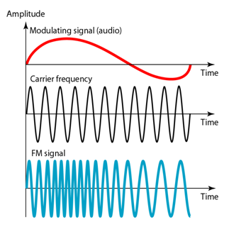
Frequency Modulation

Slide 10
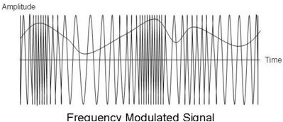
Frequency Modulation

Slide 11

Frequency Modulation
FM is normally implemented by using a voltage-controlled oscillator as with FSK. The frequency of the oscillator changes according to the input voltage which is the amplitude of the modulating signal.

Slide 12
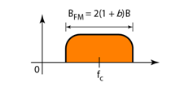
Frequency Modulation
The actual bandwidth is difficult to determine exactly, but it can be shown empirically that it is several times that of the analog modulating signal or 2(1+β)B where β is a factor depends on modulation technique with a common value of 4 and B is the bandwidth of the modulating signal.
The bandwidth of an FM signal, is approximately 10 times the bandwidth of the modulating signal.

Slide 13

Frequency Modulation

Slide 14

FM Bandwidth
The bandwidth of an audio signal (speech and music) broadcast is almost 15 kHz. Each FM radio station, therefore, needs a minimum bandwidth of 150 KHz. The FCC (Federal Communications Commission) allows 200 kHz (0.2 MHz) for each station to provide some room for guard bands.

Slide 15
FM Bandwidth
FM stations are allowed carrier frequencies anywhere between 88 and 108 MHz. Stations must be separated by at least 200 KHz to keep their bandwidths from overlapping. To create more privacy, the FCC requires that in a given area, only alternate bandwidth allocations may be used. The other remains unused to prevent any possibility of two stations interfering with each other.
Given 88 to 108 MHz as a range, there are 100 potential FM bandwidths in an area, of which 50 can operate at any one time.

Slide 16
Question
The bandwidth of a stereo audio signal is usually 15 KHz. From the following figure calculate the number of FM bandwidth according to FCC regulation that operates at any time?
The bandwidth of a stereo audio signal is usually 5 KHz. From the following figure calculate the number of AM bandwidth according to FCC regulation that operates at any time?

Slide 17
Phase Modulation (PM)
In PM, the phase of the carrier signal is modulated to follow the changing voltage level (amplitude of the modulating signal.
The peak amplitude and frequency of the carrier signal remain constant, but as the amplitude of the information signal changes, the phase of the carrier changes correspondingly.

